Slide 1
Introduction and HTTP
CSCI 3230U - Web Application Development
Walid M. Ibrahim
Walid.Ibrahim@ontariotechu.net

Slide 2
Aside - Browser Usage
https://www.youtube.com/watch?v=es9DNe0l0Qo
https://www.youtube.com/watch?v=JP1hzHfaEHw
2

Slide 3
Outline
Course overview
Network application architectures
Client-server
Three-tiered
Hypertext transfer protocol (HTTP)
URLs
Requests
Responses
Transport-layer Security (TLS)
3

Slide 4
Course Overview

Slide 5
Course Overview
Front-end development
HTML
CSS (and CSS frameworks)
JavaScript (and JS libraries)
Client-side frameworks (Vue.js)
Asynchronous requests and web services
Back-end development
Server-side frameworks (Node.js)
Database access (MongoDB/Mongoose, SQLite/sqlite3)
Socket.io
Web application security

Slide 6
Network Application Architectures

Slide 7
Network Application Architectures
Common architectures
Client-server
Applications without a database
Single-page applications (database is the server)
Three-tiered
Server and database are separated

Slide 8
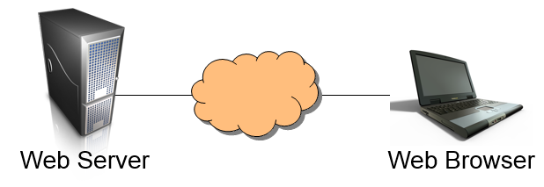
Client-Server
Server
Listens for connections
Responds to client requests
Client
Initiates the connection with the server
Issues a request to that server
Processes the server's response

Slide 9
Client-Server
Client-server was popular for applications that did not need a separate database
These are not too common today
Client-server is making a comeback, though, due to single-page applications (SPAs)
All of the functionality is on the client (browser), except for the database (e.g. Firebase)
Maybe client-database, instead of client-server

Slide 10
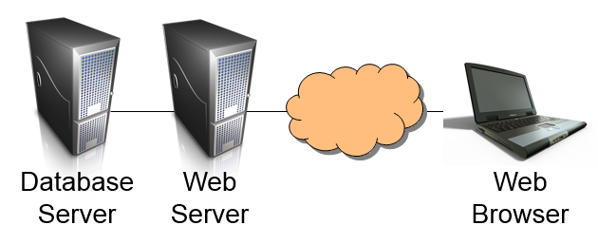
Three-tiered
An additional layer is used for data storage
SQL-based storage
NoSQL (HTTP-based) storage
The server accesses this data over the network

Slide 11
Hypertext Transfer Protocol (HTTP)

Slide 12
Uniform Resource Locators (URLs)
https://twitter.com:80/i/notifications
https - Protocol
twitter.com - Hostname
80 - Port number
/i/notifications - Uniform resource indicator
i.e. path and filename

Slide 13
HTTP
Common commands:
GET
POST
PUT
DELETE
HEAD

Slide 14
HTTP - Original Meanings
When HTTP was designed, these were the meanings:
GET download a file
POST append to a file, download resulting file
PUT upload a file
DELETE delete a file
HEAD download meta-data (headers) for a file

Slide 15
HTTP - Modern Meanings
Currently, these are the meanings:
GET download/read data
POST modify data
PUT insert new data
DELETE delete data
HEAD download meta-data (headers) for a file

Slide 16
HTTP Requests
A request is issued by the client (a web browser)
The command is the most important part of the request
Request headers contain meta-data about the request and browser
Browser (name and version) sending the request
Time/date when the request was issued
Formats that the browser can handle
Site being visited

Slide 17
HTTP Requests
An example HTTP command:
GET /folder/file.html HTTP/1.1

Slide 18
HTTP Requests
An example HTTP request:
GET / HTTP/1.1
Host: www.google.ca
Proxy-Connection: keep-alive
User-Agent: Mozilla/5.0
Accept: text/html
Accept-Language: en-US,en
Accept-Charset: ISO-8859-1,utf-8
Content-length: 0

Slide 19
HTTP Requests
To capture an HTTP request:
Issue the following command to start a passive listener
$ nc -l 8080
Go to http://localhost:8080 to issue the request from the browser

Slide 20
HTTP Responses
A response is issued by the web server in response to a request
The requested file is often the most important part of the response
Response headers contain meta-data about the response and web server
Server (name and version) sending the response
Time/date when the response was issued
Amount of data being transmitted
Data type of the data included
Cookies being transmitted

Slide 21
HTTP Responses
HTTP responses contain three parts:
Response code (https://www.restapitutorial.com/httpstatuscodes.html)
1xx Informational
100 Continue
2xx Success
200 Successful 201 Created 204 No Content
3xx Redirection
302 Redirect
4xx Client Error
401 Unauthorized 403 Forbidden 404 File Not Found
(must login) (invalid permissions) (bad URI)
5xx Server Error
500 - server-side error
Response headers
Data (optional; GET and POST)

Slide 22
HTTP Responses
Response code status categories:
1xx Informational
100 Continue
2xx Success
200 Successful 201 Created 204 No Content
3xx Redirection
302 Redirect
4xx Client Error
401 Unauthorized (must login) 403 Forbidden (invalid permissions) 404 File not found (bad URI)
5xx Server Error
500 - server-side error

Slide 23
HTTP Responses
An example HTTP response:
HTTP/1.1 200 Ok
Content-Type: text/html; charset=UTF-8
Date: Sat, 5 Jan 2020 18:42:48 GMT
Content-Length: 154
<html>
<head>
<title>Sample Response</title>
</head>
<body>
<h1>Sample response</h1>
<div>The response is here.</div>
</body>
</html>

Slide 24
Transport-layer Security (TLS)

Slide 25
Secure HTTP
The secure HTTP protocol is implemented by:
TLS
SSL

Slide 26
TLS
Outline of the TLS handshake:
Exchange information about cipher capability
Exchange certificates (or public keys)
Generate and share secret key
Confirm secret key

Slide 27
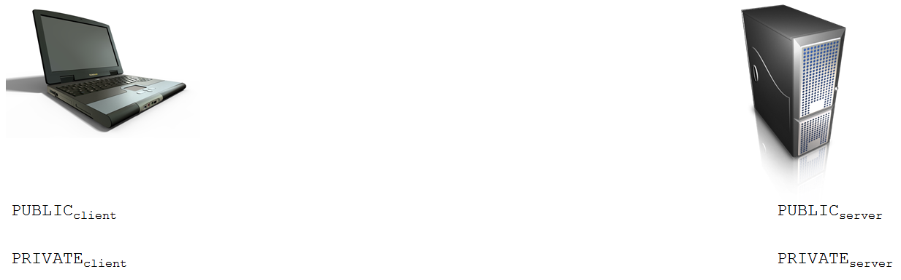
TLS

Slide 28
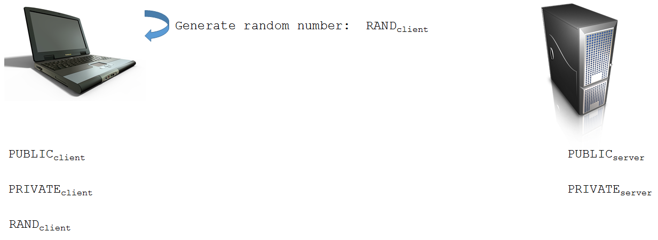
TLS

Slide 29
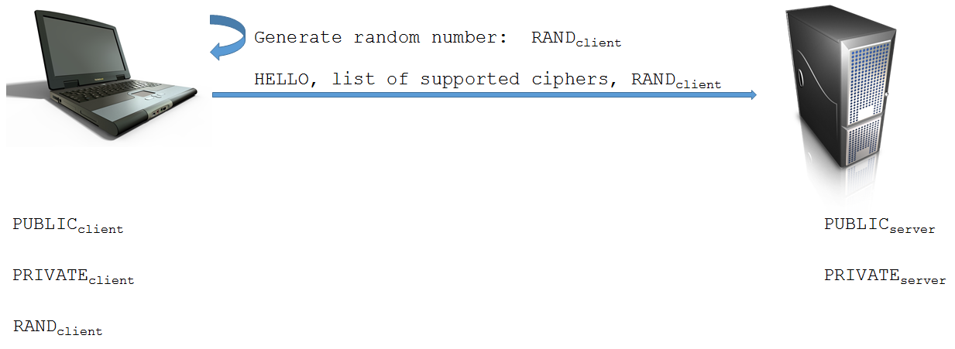
TLS

Slide 30
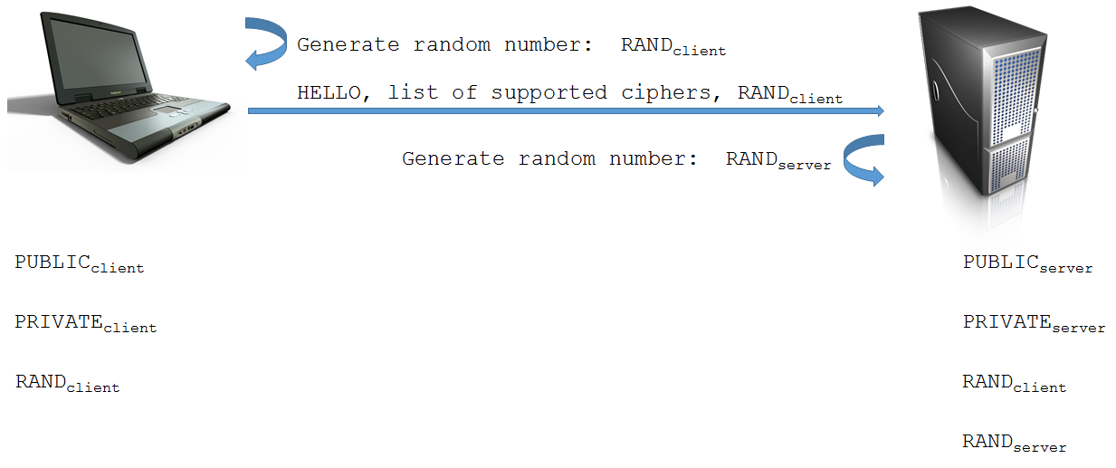
TLS

Slide 31
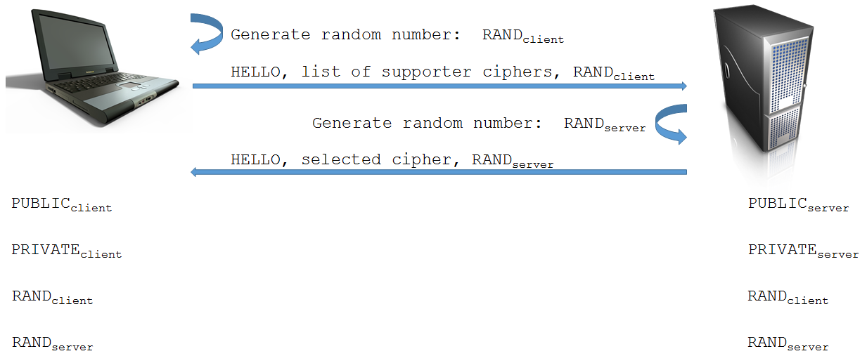
TLS

Slide 32
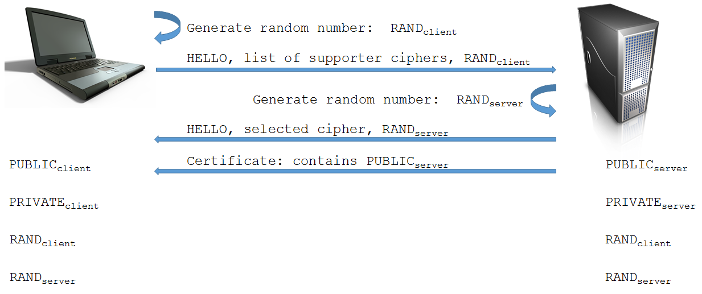
TLS

Slide 33
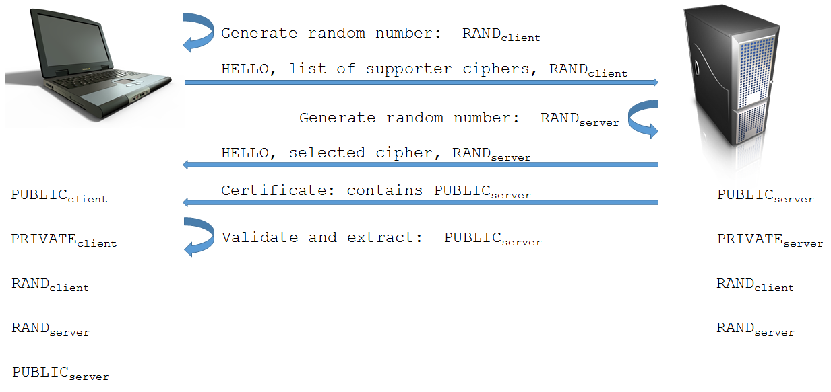
TLS

Slide 34
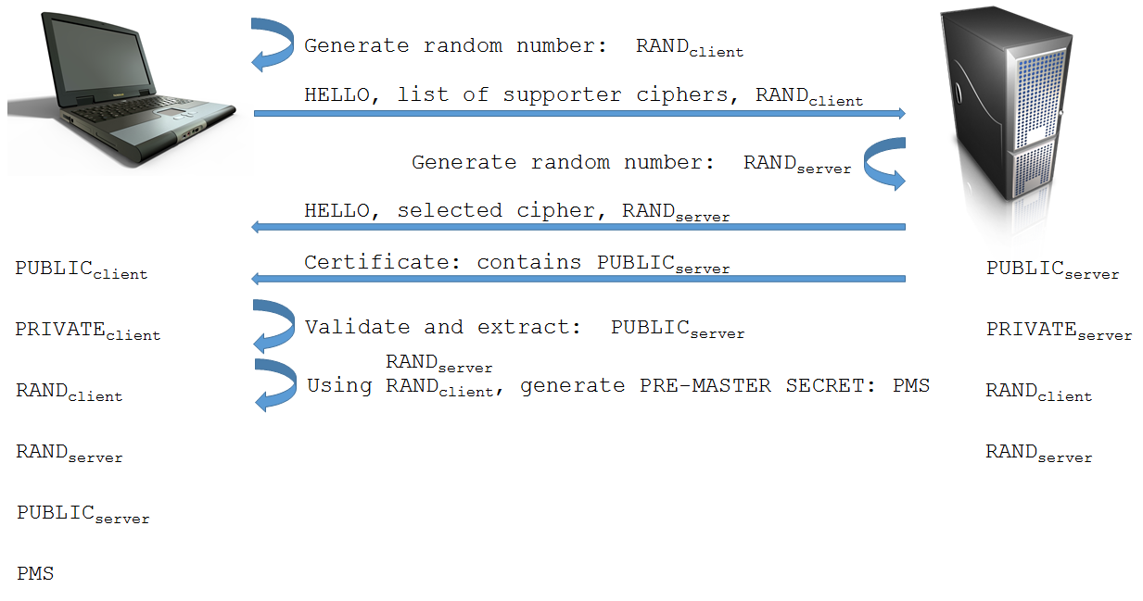
TLS

Slide 35
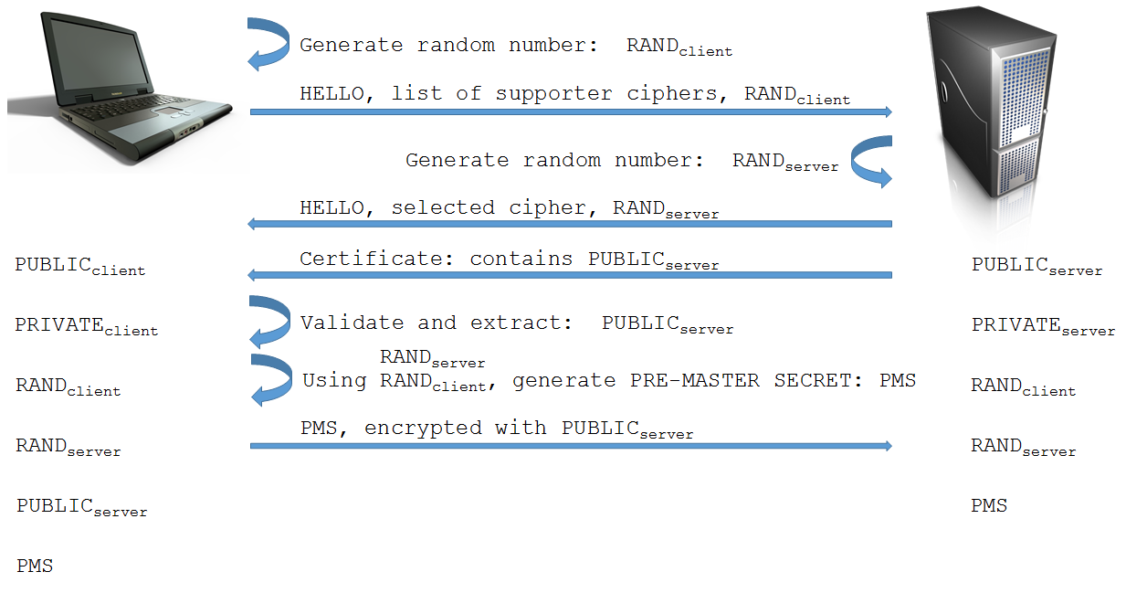
TLS

Slide 36
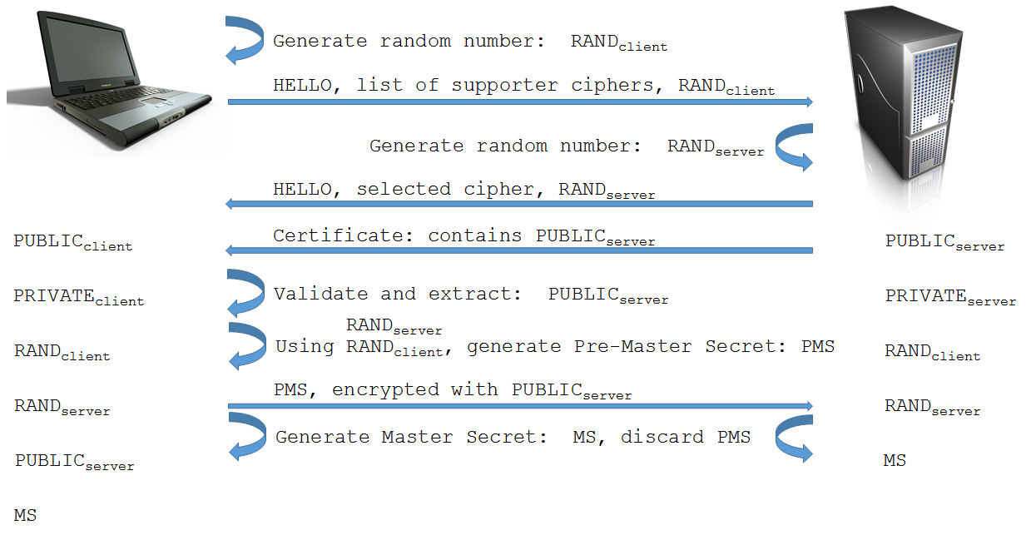
TLS

Slide 37
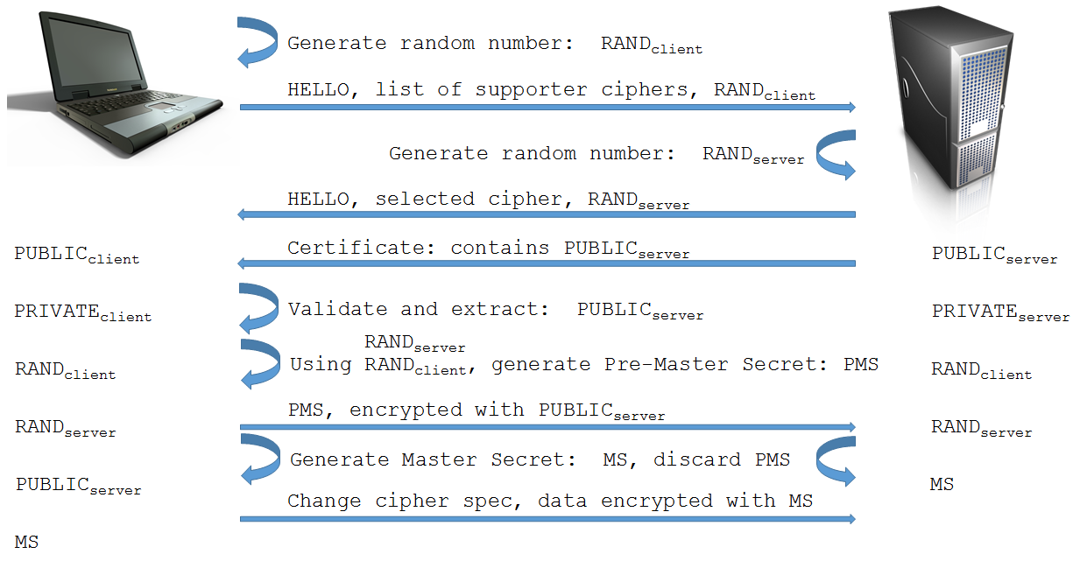
TLS

Slide 38
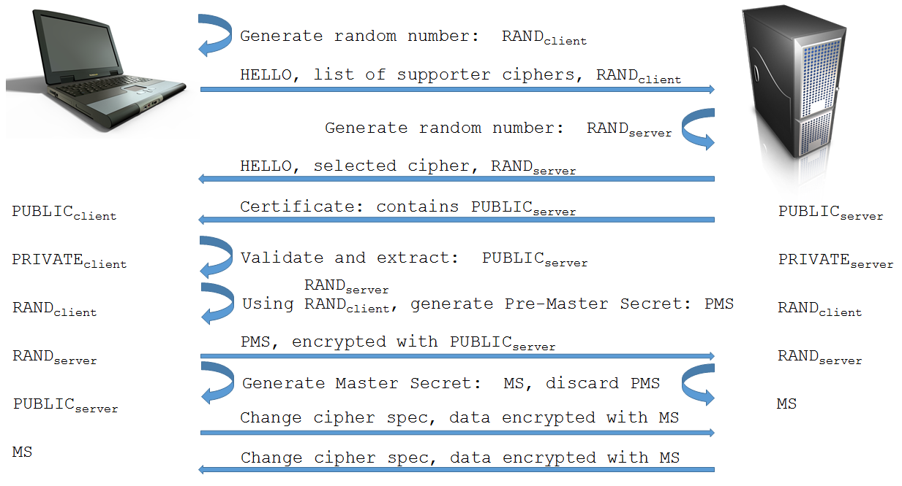
TLS

Slide 39
Keys
Secret keys
Both sender and receiver use the same key
Used by encryption algorithm to encrypt
Used by decryption algorithm to decrypt
Must be kept confidential, once shared
Public and private keys
Public: Shared with everyone
Private: Kept confidential
Same algorithm, different keys to encrypt/decrypt

Slide 40
Certificates
Certificate authorities (CA)
Trusted third party responsible for generating certificates
Their public key is widely known (installed in browsers)
A certificate is basically an encrypted public key
Self-signed: A public key encrypted with its matching private key
CA-authorized: A public key encrypted with the private key of a certificate authority
TLS and SSL use X.509 format certificates

Slide 41
Wrap-up
Course overview
Network application architectures
Client-server
Three-tiered
Hypertext transfer protocol (HTTP)
URLs
Requests
Responses
Transport-layer Security (TLS)

